Slide 1
Functional Programming Paradigm

Slide 2
Lambda Calculus
During the 1930's a mathematician investigating the foundation of mathematics, Alonzo Church, introduced a formal system of expressing computational logic .

Slide 3

Expressions in Lambda Calculus
Let $Λ$ be the set of expressions
Variables. If x is a variable, then $x∈Λ$
Abstractions. If $x$ is a variable and $ℳ∈Λ$, then $(λx.ℳ)∈Λ$.
Applications. If $ℳ∈Λ∧𝒩∈Λ$, then $(ℳ𝒩)∈Λ$.

Slide 4
Reductions
Lambda calculus defines 3 ways to reduce/simplify a lambda expression

Slide 5


$α$ equivalence:
$α$ equivalence states that any bound variable, has no inherent meaning and can be replaced by another variable:
$$λx.x\underset{α}{=}λy.y$$

Slide 6


$β$ reductions
$β$ reductions state how to simplify abstractions. This process is similar to applying the function. For example we use the identity function ($λx.x$) and apply it to some free variable $y$.
$$(λx.x)y\underset{β}{→}y$$

Slide 7


$η$ reductions
$η$ reductions describe equivalencies that arise because of free variables. If $x$ is a variable and does not appear free in $ℳ$ then:
$$λx.(ℳx)\underset{η}{→}ℳ$$

Slide 8

Reduction Example
For example to reduce the following lambda expression, we must first understand what it means.
$$(λx.λy.(xy))(λx.λy.(xy))$$
In the outermost level, the expression is the application of $λx.λy.(xy)$ to itself. It might be tempting automatically apply a $β$ reduction by itself:
$$\begin{matrix}(λx.λy.(xy))(λx.λy.(xy)) & \underset{β}{→}λy.((λx.λy.(xy))y) \\ & \underset{β}{→}λy.λy.(yy)\end{matrix}$$

Slide 9

Reduction Example
But this reduction is actually incorrect because the although $x$ and $y$ appear on both lambda expressions, these variables don't have the same meaning . The $x$ and $y$ variables inside the left lambda expression are bound inside this lambda expression.

Slide 10

Reductions Example
The $x$ and $y$ variables outside the left lambda expression (inside the right lambda expression) are free in its context, therefore, even though they look the same, it is incorrect to interchange the two variables.

Slide 11

Reduction Example
Two avoid confusion with similarly named variables, it is advisable to apply an $α$ equivalency, to give them different names:
$$\left(λx.λy.\left(xy\right)\right)\left(λx.λy.\left(xy\right)\right)\underset{α}{≡}\left(λx.λy.\left(xy\right)\right)\left(λu.λv.\left(uv\right)\right)$$
The correct reduction in this case is as follows:
$$\begin{matrix}(λx.λy.(xy))(λu.λv.(uv)) & \underset{β}{→}λy.((λu.λv.(uv))y) \\ & \underset{β}{→}λy.λv.(yv)\end{matrix}$$

Slide 12
the functional paradigm

Slide 13
Reimagined functions
Lambda calculus evolved from a system of logic foundation with deep roots to computation theory into something that became a basis for programming language design.

Slide 14
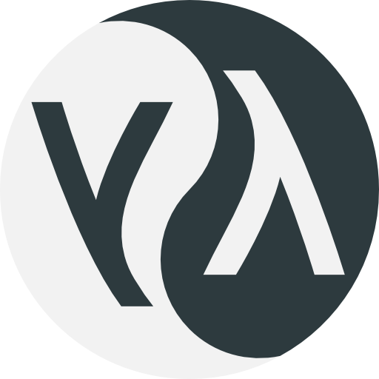

Reimagined Functions
Around 1950's programming languages patterned around the framework of lambda calculus started to emerge.
Common Lisp
Haskell
Common Lisp Logo from https://common-lisp.net/ by Lisp under CC BY-SA
Haskell Logo from Thompson-Wheeler logo on the haskell wiki under the haskell wiki copyright license

Slide 15
Treating functions differently
One of the biggest difference between your classic imperative programming languages like C and Java and a functional programming language, is how it treat its function

Slide 16

Comparing functions (definition)
int square(int x){ return x*x; }
square x = x * x

Slide 17
Comparing functions (invocation)
square(5);
square 5

Slide 18
Although functions in non-functional programming behave and look similar to functions in functional programming language, they have a huge difference in their treatment

Slide 19
Imperative Functions (Procedures or Methods)
A function in C is treated differently from other types of data.
Canonical value types like integers, characters, and arrays can’t be passed on functions and can’t be returned as functions.

Slide 20
Imperative Functions (Procedures or Methods)
int* add_to_array(int arr*,int x,int size){ for(int i=0;i<size;i++){ arr[i]+x; } return arr; }

Slide 21

Imperative Functions (Procedures or Methods)
During runtime, non-functional programming languages interpret the expression square(5) as "the number $5$ squared" while the expression square is just some disembodied function name.
Imperative programming functions during runtime are meaningless unless they are directly invoked.

Slide 22
Higher Order Functions
Functional programming languages treat functions the same way it treats values, you can pass them as in functions and you can return them as well.
s:: Int -> Int func x = x + 1 p::Int -> Int func x = x - 1 applytwice:: (Int-> Int) -> Int -> Int applytwice f x = f (f x)

Slide 23
Higher Order Functions
The third function is what we call a higher order function. A higher order function is a function that either accepts a function as a parameter or returns a function parameter or both.
applytwice:: (Int-> Int) -> Int -> Int applytwice f x = f (f x)

Slide 24
Higher Order Functions
By defining a function like this we can do something like this during runtime:
ghci> applytwice s 3 5 ghci> applytwice p 3 1

Slide 25
Why is this even a feature?

Slide 26

Higher order functions
This is not some arbitrary added feature as well since this is directly patterned from lambda calculus:
$$\begin{matrix}let S & =λn.λs.λz.(s(nsz)) \\ T & =λf.λx.(f(fx)) \\ \overline{5} & =TS\overline{3}\end{matrix}$$

Slide 27
Higher Order Functions
In lambda calculus an abstraction and an application does not restrict anyone from the type of expressions bound to variables.

Slide 28
Higher Order Functions
On the other side of the coin, a function, in functional programming will also let you return functions the same way you return any other kind of data.

Slide 29
Higher Order Functions
Suppose we have different functions that when applied to an integer, produces that integer plus a certain integer.
addTwo::Int -> Int addTwo = x = x + 2 addThree::Int -> Int addThree x = x + 3 addFour:: Int -> Int addFour = x + 4

Slide 30
Higher Order Functions
We can generalize these functions into a function-maker function
addMaker::Int -> (Int->Int) addMaker x = (\y -> x + y)

Slide 31

Higher Order Functions
This is a representation of an expression we already know from lambda calculus. addMaker is basically an implementation of the lambda expression below.
$$λy.add xy$$

Slide 32
Higher Order Functions (lambda expressions)
addMaker produces a lambda expression, which essentially behaves exactly like a function. This allows you to create functions during runtime
ghci> addSix = addMaker 6

Slide 33
Higher Order Functions (lambda expressions)
Simply writing the expression addSix on your terminal will yield you an error, because printing addSix doesn't really have a meaning outside the world of lambda calculus.

Slide 34
Higher Order Functions (lambda expressions)
But since addSix is a lambda that behaves exactly like a function, you can apply addSix to an integer and it will give you a meaningful answer.
ghci> addSix 3 9

Slide 35
Higher Order Functions (lambda expressions)
In fact you can even omit the part where you bind the value returned by addMaker to a name, and instead use it directly.
ghci> (addMaker 7) 4 11

Slide 36
Higher Order Functions (lambda expressions)
This nifty trick right here is the reason why lambda expressions are also called anonymous functions since these expressions on their own don't have a name.
Notes:
Lambda expressions generally appear in functional programing languages and even non-strictly functional programming languages. Lambdas can be useful if you want to create a function that will be used only once:
ghci> applytwice (\x -> x + 2) 3 7 ghci> (\x -> x * x) 4 16

Slide 37
Higher Order Functions (closure)
A higher order function is not only producing the lambda inside its definition. It produces a construct called a closure which is the function definition described by the lambda and the environment of the function call.

Slide 38
Higher Order Functions (closure)
The extra data, called environment, is the reason why the lambda,
(\y -> x + y) makes sense outside the context of addMaker.

Slide 39

Multiple Parameters and Partial Application
If we look back to lambda calculus you'll notice how abstractions are defined to be:
$$(λx.ℳ)∈Λ$$

Slide 40
Multiple Parameters and Partial Application
Abstractions are defined to have exactly one parameter which is different from functions in programming which can have 0 or more parameters

Slide 41
Multiple Parameters and Partial Application
These functions are just disguised to have multiple parameters.
These functions are just several single parameter functions combined to simulate multiple parameter functions.

Slide 42
Multiple Parameters and Partial Application
As an example: a function add that adds two numbers may look like multiple parameter functions:
plus x y = x + y

Slide 43
Multiple Parameters and Partial Application
But internally this function is equivalent to two lambda calculus abstractions, nested together to simulate multiparameterness
plus = \x -> (\y -> x + y)

Slide 44

Multiple Parameters and Partial Application
Here add is a higher-level function that accepts a single argument x and produces a lambda expression.
This expression is a direct implementation of the following lambda calculus abstraction:
$$plus=λx.λy.add xy$$

Slide 45
Multiple Parameters and Partial Application
Haskell's -> operator is right associative so you can write the same plus function as:
plus = \x -> \y -> x + y
You can even omit the first -> and the \ near y and it will mean the same lambda expression:
plus = \x y -> x + y
Notes:
Which looks almost exactly similar to a relaxed lambda calculus expression with multiple parameters:
$$λxy.add xy$$

Slide 46
Multiple Parameters and Partial Application
Now when you want to apply this function we write:
ghci> (plus 3) 4 7
Notes:
Which means that first we are evaluating (plus 3) which will give us a lambda expression. The lambda expression is then applied to 4 which completes the evaluation to 7. This is also a direct implementation of a lambda calculus application:
$$(plus \overline{3})\overline{4}$$

Slide 47
Multiple Parameters and Partial Application
Function applications in Haskell is also left associative so you can omit the parentheses:
ghci> plus 3 4 7
Notes:
Which means that first we are evaluating (plus 3) which will give us a lambda expression. The lambda expression is then applied to 4 which completes the evaluation to 7. This is also a direct implementation of a lambda calculus application:
$$(plus \overline{3})\overline{4}$$

Slide 48
Multiple Parameters and Partial Application
All multiple parameter functions and lambdas in Haskell are implemented are nested single parameter abstractions in disguise
plus x y = x + y
plus = \x -> (\y -> x + y)
Notes:
Which means that first we are evaluating (plus 3) which will give us a lambda expression. The lambda expression is then applied to 4 which completes the evaluation to 7. This is also a direct implementation of a lambda calculus application:
$$(plus \overline{3})\overline{4}$$

Slide 49
Multiple Parameters and Partial Application
This means that the expression(plus 3) will have the same meaning regardless of the way you define plus. The expression (plus 3) has a special name, it is called a partial application.

Slide 50

Multiple Parameters and Partial Application
When you apply a function that is supposed to accept $n$ parameters to $m$ values (where $m<n$), instead of getting the value, you get a partial application of that function which will evaluate to a lambda expression.

Slide 51
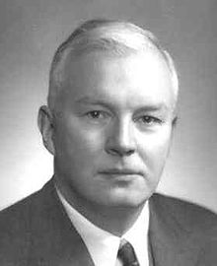
Multiple Parameters and Partial Application
The process of converting a multi parameter function or lambda to a nested single parameter lambda is called currying.
Haskell Brooks Curry
Photo of Haskell Brooks Curry by Gleb.svechnikov under CC BY-SA

Slide 52
Functional Purity and the Absence of States
One of the most distinguishing aspects of functional programming is its philosophy of statelessness.
Programmers exposed to state and mutation find that the concept of state is natural and maybe even inevitable.

Slide 53
Functional Purity and the Absence of States
Functional paradigm challenges this concept and offers a much safer and mathematically intuitive philosophy.
In the perspective of functional programming, there is no state, and everything is immutable.

Slide 54
Pure Functions
Functions in functional programming languages like Haskell are (arguably) the closest computer representation of a mathematical function. We call these functions, pure functions.
Notes:
Across several, mathematical disciplines a function means the same thing. Consider two sets $A$ and $B$. we can define a function as the mapping between the elements of $A$ and $B$. The elements of $A$ and $B$ can be anything, they can be numbers, which shows us how a function can be represented by a formula or a graph. The elements of $A$ and $B$ can be matrices and vectors, which defines a function as a transformation between two vector spaces. On the higher level perspective of category theory, functions are morphisms between objects of a given category. At its core a function basically defines arrows between things.

Slide 55
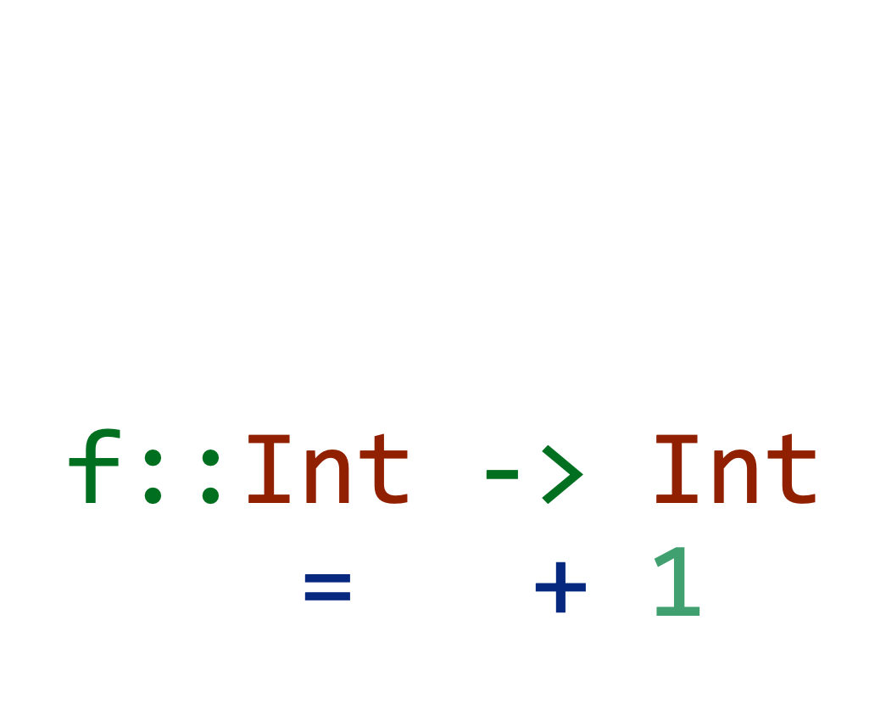
$$f:Z→Z \\ f\left(x\right)=x+1$$ f::Int -> Int f x = x + 1

Slide 56
Impure Functions (side-effect)
int square(int x){ addToExternalLogger("calculating square"); return x*x; }

Slide 57
Impure Functions (side-effect)
int square(int x){ addToExternalLogger("calculating square"); return x*x; }

Slide 58
Impure Functions (mutation)
void increaseArray(int *a, int size){ for(int i = 0; i < size; i++) a[i]+1; }

Slide 59

Impure Functions (relational)
String headsortails(){ if(randInt()%2==0) return "heads"; else return "tails"; }

Slide 60
Functional Purity
A pure function must satisfy these two:
A pure function has no side-effects
A pure functions output must be dependent on the inputs alone

Slide 61
Functional Purity
A good way to test if a function is pure is if you can (theoretically) create an infinitely long lookup table such that looking up the value for a specific input is perfectly identical to calling the function with the same input.

Slide 62
x | f(x)
1 | 1
2 | 4
3 | 9
4 | 16
5 | 25
6 | 36
7 | 49
8 | 64
9 | 81
10 | 100
11 | 121
12 | 144
13 | 169
14 | 196
15 | 225
16 | 256
17 | 289
18 | 324
19 | 361

Slide 63
Absence of mutation
Purely functional programming languages like Haskell, lacks the mechanism to mutate anything.
Using the "=" operator in functional languages binds the value on the right-hand side to the left-hand side.

Slide 64
Absence of mutation
Destructive assignment in Haskell is in fact not allowed
x = 0 x = 1
main.hs:2:1: error: Multiple declarations of ‘x’ Declared at: main.hs:1:1 main.hs:2:1

Slide 65
Consequences of Statelessness
Although Haskell's functions are our best representation of a mathematical function, this does not mean that it is pragmatically better than the classic impure functions of C.

Slide 66
Consequences of Statelessness
Restricting a programming language against side-effects seems like an artificial disadvantage introduced only to faithfully implement mathematical functions.

Slide 67
Programming without state
void f(int *x, int y){
*x = *x + y;
printf("%d\n",*x);
return;
}
int main(void) {
int x = 0;
f(&x, 3);
x = x - 2;
f(&x, 3);
}

Slide 68
Programming without state
Building a library of functions perfectly working without worrying about side-effects makes the system easier to understand and more resilient to changes.

Slide 69
Programming without state
On small chunks of code, managing the consequences of having states such as global variables, will be trivial since you can reasonably track which variables are global (or external in general) and which functions interact with the global variables.

Slide 70
Programming without state
As the system grows, using functions and variables without double checking for side effects becomes much harder.

Slide 71
Programming without state
Consequently the whole system becomes a nightmare of impure functions on top of impure functions which may unexpectedly affect other parts of the system.
Notes:
On a corporate setting where multiple people are working on the same system, refactoring becomes unsafe without knowledge of all the side-effects of the functions in use. On systems with shared resources and multi-threading it becomes extra-extra difficult to keep track of things without proper documentation.

Slide 72
Programming without state
Even with all these disadvantages in the state-full mutable paradigm of imperative programming, one can still code robust and harmonious systems.

Slide 73
Programming without state
Programmers must be extra careful writing your code with discipline, only using globals and side-effects when it is safe and necessary
Notes:
this is in fact the reason why writing smaller pure functions is better in general

Slide 74
Programming without state
After all, being able to code with states can be thought of as an extra feature. You can be a C programmer and just treat all your variables as immutable and all your functions as pure.

Slide 75
Disadvantages of Functional Programming
Functional programming has its own set of disadvantages as well, most of them related to this artificial crutch of statelessness and immutability.

Slide 76
Disadvantages of functional programming
Creating new values instead of changing an existing variable has extra overhead in both processing and memory, making functional programming slower and less efficient.

Slide 77
Disadvantages of functional programming
Programming without state can be difficult to do for certain mechanisms (Like the external logger for example).

Slide 78
Disadvantages of functional programming
Simulating mechanisms like this may introduce conflict on how you compose your functions.
It's not impossible though, you just have to learn some category theory concepts such as monads and functors

Slide 79
Disadvantages of functional programming
For most people who are used imperative programming, recursion, does not feel natural at all

Slide 80
Disadvantages of Functional Programming
Nevertheless, these disadvantages are not insurmountable. In fact, there are a plenty of systems written in functional programming languages running without issues.

Slide 81
Disadvantages of Functional Programming
Functional programming has had the reputation of being more conceptual and fancier than the classic imperative programming language.
But recently functional programming languages like Haskell, F# and Scala has enjoyed improvements that has elevated it to be as pragmatic as your classic C, C++ or Java

Slide 82
Disadvantages of Functional Programming
Functional programming has gained a rise in popularity to an extent that mainstream programming languages like C#, Python, and JavaScript have started to introduced features patterned from pure functional programming languages (Features such as higher-order functions and lambdas).

Slide 83
Disadvantages of Functional Programming
Functional programming has gained a rise in popularity to an extent that mainstream programming languages like C#, Python, and JavaScript have started to introduced features patterned from pure functional programming languages (Features such as higher-order functions and lambdas).

Slide 84
learning functional programming concepts has become a necessity for any programmer.

Slide 85
References
Church, A. (1932). A Set of Postulates for the Foundation of Logic. Annals of Mathematics,33 (2), second series, 346-366. doi:10.2307/1968337
Steele, A. (1996). The Evolution of Lisp. History of programming languages, 233-330. doi:10.1145/234286.1057818
Photo of Haskell Brooks Curry by Gleb.svechnikov under CC BY-SA

Slide 86
References
Common Lisp Logo from https://common-lisp.net/ by Lisp under CC BY-SA
Haskell Logo from Thompson-Wheeler logo on the haskell wiki under the haskell wiki copyright license

